Slide 1
Abundance analysis
Nicole Angeli
Anna Tucker
Conor McGowan

Slide 2
Presence/absence data vs. abundance data
Example 1: A researcher conducts point counts for birds in the same forest plot each summer. During point counts, they make an effort to detect and record every species and count the individuals within the survey window.
Example 2: A National Park office often gets reports from people who have seen wolverines in the park. They keep track of the locations and dates of these sights and they send two temp interns to set-up and camera traps randomly throughout the park to capture wolverine on tape.
Example 3: A natural history museum has plant specimens that contain information about the location and date of collection, which can be used to map historical occurrence of the species. Associated field notebooks record the number of total unique plants along the same paths each year for 25 years.

Slide 3
Abundance data
When we have information at repeated places over repeated time periods
-camera traps
-hair/eDNA traps (unique individuals over time)
-transect surveys
-distance sampling
What else can you think of?

Slide 4
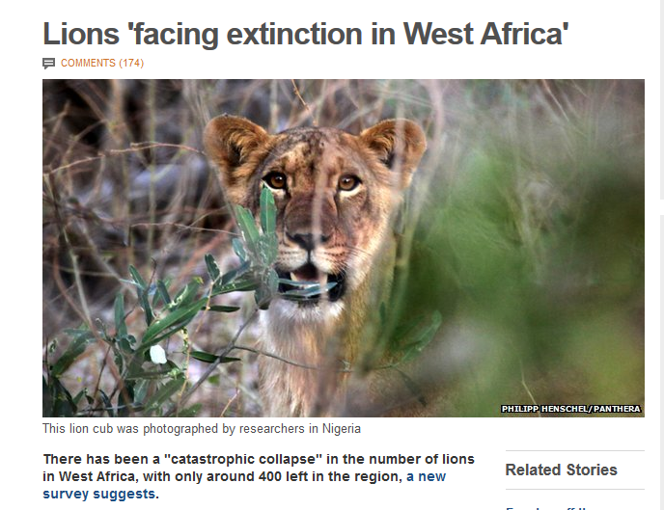
It is difficult to estimate the abundance of animals….yet, we try.
~400

Slide 5
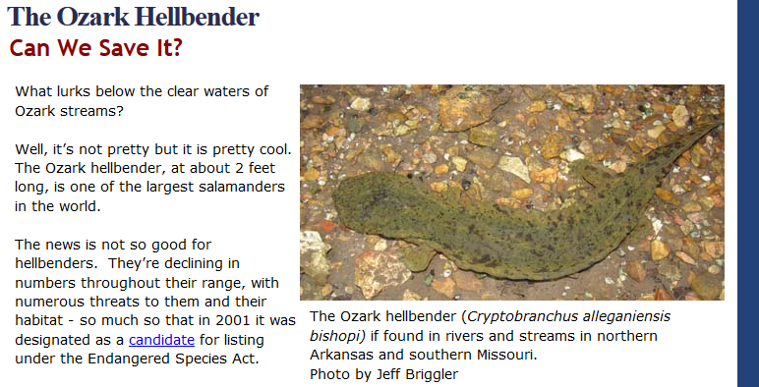
It is difficult to estimate the abundance of animals….yet, we try.
~400
~590

Slide 6

It is difficult to estimate the abundance of animals….yet, we try.
~7600

Slide 7
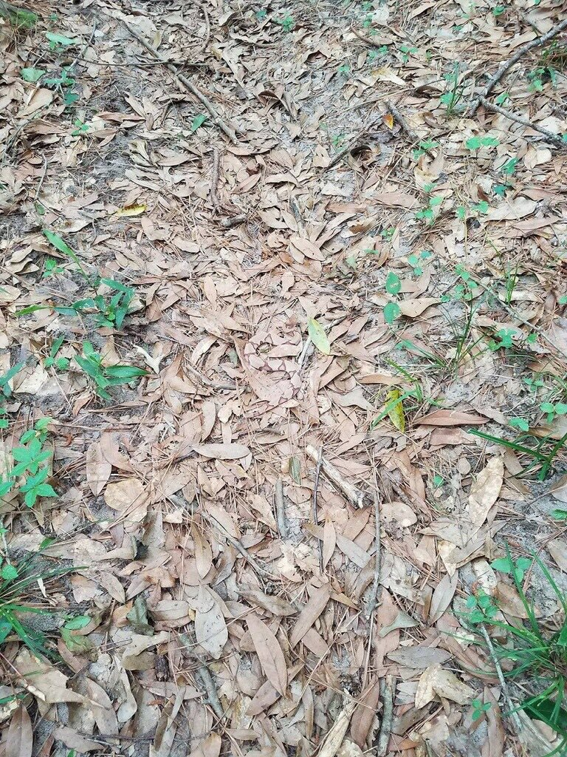
Two issues with abundance estimates
Detectability &
Spatial Indexing

Slide 8
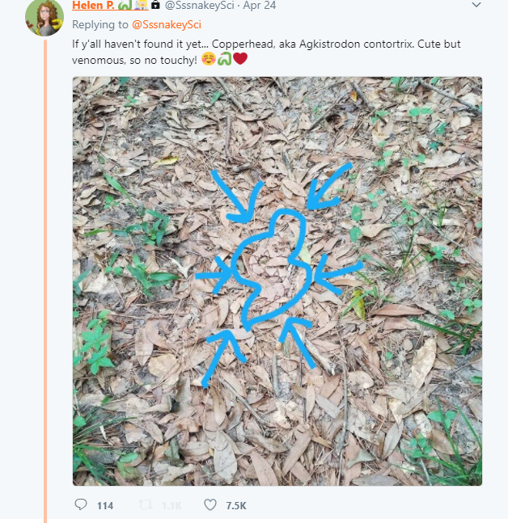
Two issues with abundance estimates
Detectability &
Spatial Indexing
6,925 Retweets
23,876 Likes
Notes:
Detection is not only interesting from a theoretical modeling standpoint, but for public interest! It’s important that we can communicate clearly how we are estimating abundance when a copperhead like this blends into the background!

Slide 9
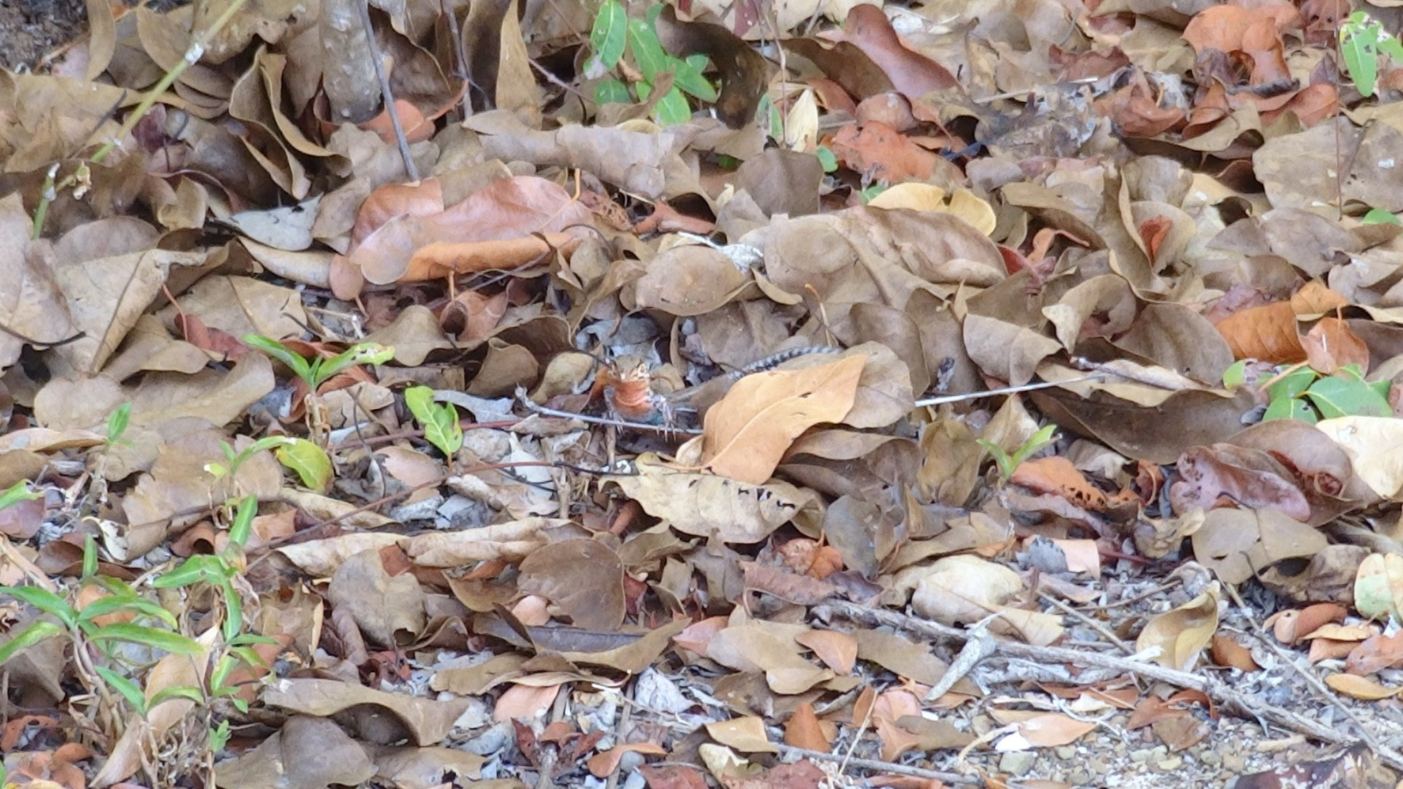

Issue 1: Detectability
-animals aren’t always available,
-not detectable (spatial heterogeneity),
-intra-specific variation
Estimating site occupancy rates when detection probabilities are less than one (Mackenzie, Nichols, Lachman, Droege, Royle, Langtimm. 2002. Ecology.)
Notes:
Discuss these three (and other) types of observation processes

Slide 10
Issue 1: Detectability
-animals aren’t always available,
-not detectable (spatial heterogeneity),
-intra-specific variation
Estimating site occupancy rates when detection probabilities are less than one (Mackenzie, Nichols, Lachman, Droege, Royle, Langtimm. 2002. Ecology.)
Notes:
Show example of endangered St. Croix ground lizard. During surveys, this female stood very still and was nearly impossible to identify.

Slide 11


Different patterns predict processes, behaviors, life history
Issue 2: Spatial indexing, i.e. spatial autocorrelation
Random Uniform Clustered
Notes:
Ponds, streams, forest edges, etc. all have different resources like mates and food that create different spatial patterns that influence detection processes.

Slide 12
N-mixture models solve both issues:
Submodel 1: Model for abundance (N) solves issue 1
N_{it} ~ f(λ_{i})
Submodel 2: Model for latent variation – spatial, temporal solves issue 2
C_{ijt} ~g(N_{it}, p_{ijt})

Slide 13
Model assumptions
-Sites still closed to immigration/emigration
-Detection process is independent at each site,
but now it can can vary among sites
Useful case study: St. Croix ground lizard

Slide 14
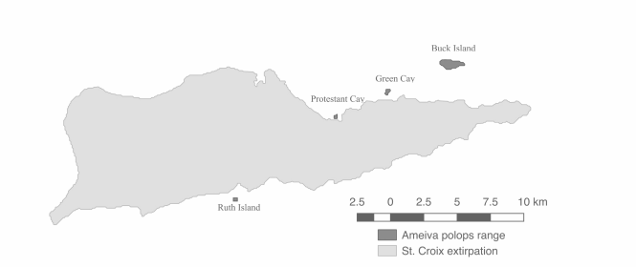
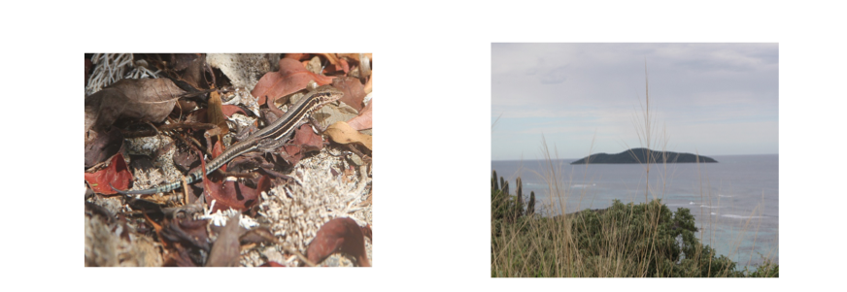
St. Croix ground lizard
57 individuals
Notes:
Example from nuts to soup. Needed abundance of St. Croix ground lizard (that was hard to see) and released by FWS and NPS to make a new population.

Slide 15
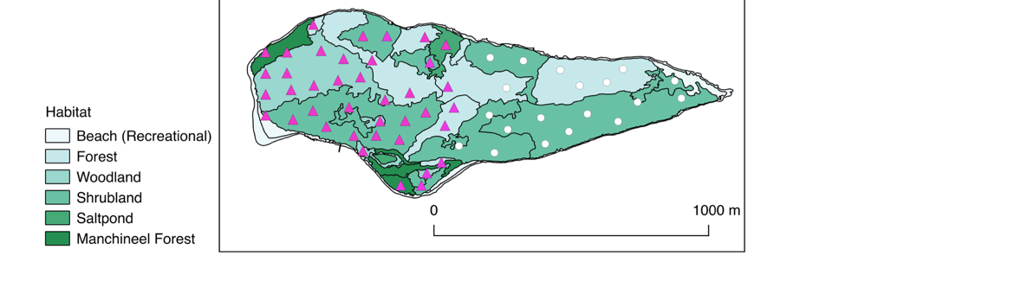
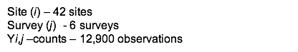
Assumption: Site independence
Each site was >80 m apart,
Surveyed within 4 days,
Sites randomly stratified by habitat
Notes:
The sites that we surveyed were for abundance (purple triangles) and occupancy all including white circles.

Slide 16
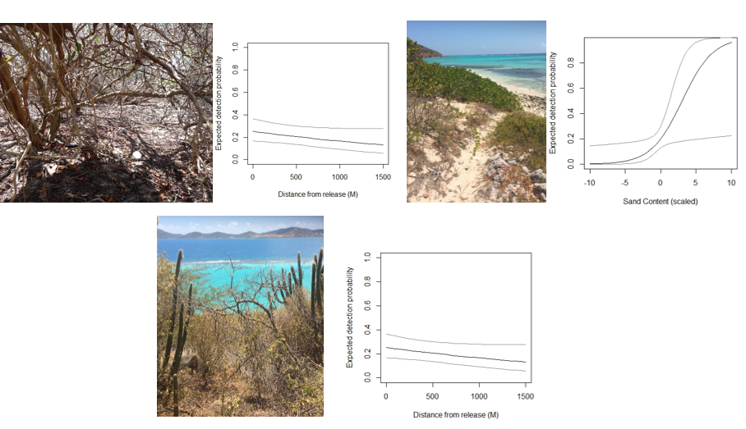
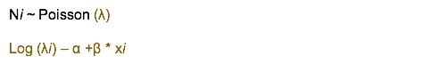
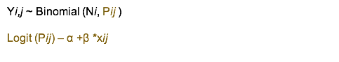
Because the sites’ detection can co-vary, we can estimate detection across sites based on things that vary between sites.
Here, top right and bottom middle are the different detection rates in shrubland (top) versus woodland (bottom). The detection across sites as it varies by sand is shown in the upper right.
Notes:
We found no effect of release site (i.e., greater density) on the lizards in two different kinds of habitat (L) but we did find an effect of sand cover where it is easier to see lizards!!! We found different detection in all of the different types of habitat i.e= if lizards are PRESENT or absent in an density, it was difficult to see them

Slide 17
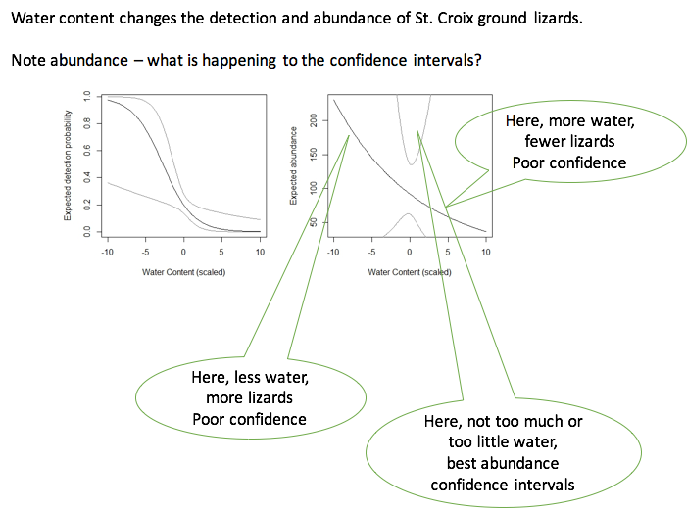
N-mixture model covariates can aid in understanding species interactions
Notes:
Water - not significant for final model, but as single covariate

Slide 18
Conclusion: Occupancy and abundance models are two ways to survey and often the same dataset can give you both estimates (i.e., the data can be transformed to fit a specific model).
Occupancy models are the poor man’s abundance
Prioritize N-mixture models if possible

Slide 19
Presence/absence data vs. abundance data – were you right?
Example 1: A research conducts point counts for birds in the same forest plot each summer. During point counts, they make an effort to detect and record every species and count the individuals within the survey window.
Example 2: A National Park office often gets reports from people who have seen wolverines in the park. They keep track of the locations and dates of these sights and they send two temp interns to set-up and camera traps randomly throughout the park for two years in a row to capture wolverine on tape.
Example 3: A natural history museum has plant specimens that contain information about the location and date of collection, which can be used to map historical occurrence of the species. Associated field notebooks record the number of total unique plants along the same paths each year for 25 years.

Slide 20
Extra perspective (optional)
N-mixture models are occupancy models
Model 1: state
z_{i,t} ~ Bernoulli(ψ_{i})
Model 2: observation
y_{i,j,t} ~Bernoulli(z_{i,t}, p_{i,j,t})
Model 1: state
N_{i,t} ~ Poisson(λ_{i})
Model 2: observation
y_{i,j,t} ~Binomial(N_{i}, p_{i,t})
Model 1: state
N_{i,t} ~ Poisson(λ_{i})
Model 2: observation
y_{i,j,t} ~Multinom(N_{i}, f(p_{it}))
MacKenzie et al. (Ecol., 2002); Tyre et al. (Ecol. App., 2003)
Royle & Nichols, (Ecol, 2003)
Royle, (Animal Bio. and Cons, 2004)
Notes:
-N is latent state; data is in y; lambda is abundance; z is the initial state;
-nit is a detection function process
-One application of third type: animal cues like fecal pellets can be assessed when instead of multinomial poisson is used for observation process

Slide 21
What kind of data

